Slide 1
Chapter 9: Noninterference and Policy Composition
Overview
Composition Problem
Deterministic Noninterference
Nondeducibility
Generalized Noninterference
Restrictiveness

Slide 2
Overview
Problem
  Policy composition
Noninterference
  HIGH inputs affect LOW outputs
Nondeducibility
  HIGH inputs can be determined from LOW outputs
Restrictiveness
  When can policies be composed successfully

Slide 3
Topics
Overview
Composition Problem
Deterministic Noninterference
Nondeducibility
Generalized Noninterference
Restrictiveness

Slide 4
Composition of Policies
Two organizations have two security policies
They merge
  How do they combine security policies to create one security policy?
  Can they create a coherent, consistent security policy?

Slide 5
Composition of Bell-LaPadula
Why?
  Some standards require secure components to be connected to form secure (distributed, networked) system
Question
  Under what conditions is this secure?
Assumptions
  Implementation of systems precise with respect to each system’s security policy

Slide 6
Issues
Compose the lattices
What is relationship among labels?
  If the same, trivial
  If different, new lattice must reflect the relationships among the levels

Slide 7
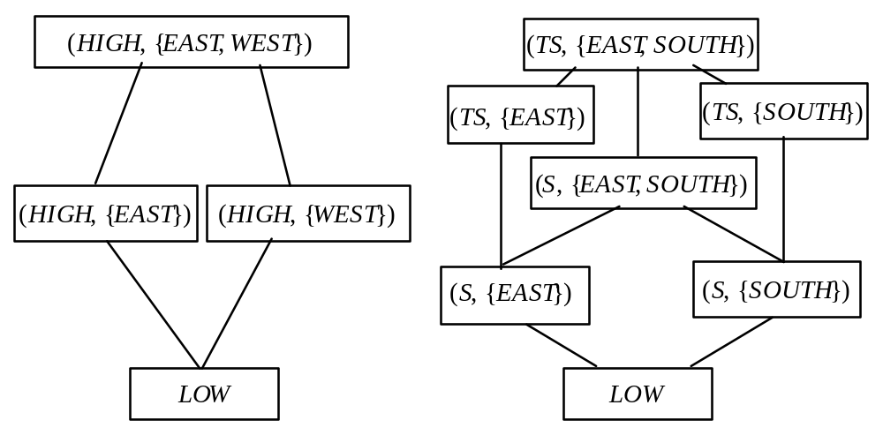
Example

Slide 8
Analysis
Assume S < HIGH < TS
Assume SOUTH, EAST, WEST different
Resulting lattice has:
  4 clearances (LOW < S < HIGH < TS)
  3 categories (SOUTH, EAST, WEST)

Slide 9
Same Policies
If we can change policies that components must meet, composition is trivial (as above)
If we cannot, we must show composition meets the same policy as that of components; this can be very hard

Slide 10
Different Policies
What does “secure” now mean?
Which policy (components) dominates?
Possible principles:
  Any access allowed by policy of a component must be allowed by composition of components (autonomy)
  Any access forbidden by policy of a component must be forbidden by composition of components (security)

Slide 11
Implications
Composite system satisfies security policy of components as components’ policies take precedence
If something neither allowed nor forbidden by principles, then:
  Allow it (Gong & Qian)
  Disallow it (Fail-Safe Defaults)

Slide 12
Example
System X: Bob can’t access Alice’s files
System Y: Eve, Lilith can access each other’s files
Composition policy:
  Bob can access Eve’s files
  Lilith can access Alice’s files
Question: can Bob access Lilith’s files?

Slide 13
Solution (Gong & Qian)
Notation:
  (a, b): a can read b’s files
  AS(x): access set of system x
Set-up:
  AS(X) = ∅
  AS(Y) = { (Eve, Lilith), (Lilith, Eve) }
  AS(X∪Y) = { (Bob, Eve), (Lilith, Alice),
  (Eve, Lilith), (Lilith, Eve) }

Slide 14
Solution (Gong & Qian)
Compute transitive closure of AS(X∪Y):
  AS(X∪Y)⁺ = {
  (Bob, Eve), (Bob, Lilith), (Bob, Alice),
  (Eve, Lilith), (Eve, Alice),
  (Lilith, Eve), (Lilith, Alice) }
Delete accesses conflicting with policies of components:
  Delete (Bob, Alice)
(Bob, Lilith) in set, so Bob can access Lilith’s files

Slide 15
Idea
Composition of policies allows accesses not mentioned by original policies
Generate all possible allowed accesses
  Computation of transitive closure
Eliminate forbidden accesses
  Removal of accesses disallowed by individual access policies
Everything else is allowed
Note; determining if access allowed is of polynomial complexity

Slide 16
Interference - Example
Single system with 2 users
  Each has own virtual machine
  Holly at system high, Lara at system low so they cannot communicate directly
CPU shared between VMs based on load
  Forms a covert channel through which Holly, Lara can communicate

Slide 17
Example Protocol
Holly, Lara agree:
  Begin at noon
  Lara will sample CPU utilization every minute
  To send 1 bit, Holly runs program
    Raises CPU utilization to over 60%
  To send 0 bit, Holly does not run program
    CPU utilization will be under 40%
Not “writing” in traditional sense
  But information flows from Holly to Lara

Slide 18
Policy vs. Mechanism
Can be hard to separate these
In the abstract: CPU forms channel along which information can be transmitted
  Violates *-property
  Not “writing” in traditional sense
Conclusions:
  Model does not give sufficient conditions to prevent communication, or
  System is improperly abstracted; need a better definition of “writing”

Slide 19
Interference
Think of it as something used in communication
  Holly/Lara example: Holly interferes with the CPU utilization, and Lara detects it—communication
Plays role of writing (interfering) and reading (detecting the interference)

Slide 20
Model
System as state machine
  Subjects S = { s_{i} }
  States Σ = { σ_{i} }
  Outputs O = { o_{i} }
  Commands Z = { z_{i} }
  State transition commands C = S × Z
Note: no inputs
  Encode either as selection of commands or in state transition commands

Slide 21
Functions
State transition function T: C×Σ→Σ
  Describes effect of executing command c in state σ
Output function P: C×Σ→O
  Output of machine when executing command c in state s (values of variables written by c)
Initial state is σ₀

Slide 22
Example
Users Heidi (high), Lucy (low)
2 bits of state, H (high) and L (low)
  System state is (H, L) where H, L are 0, 1
2 commands: xor0, xor1 do xor with 0, 1
  Operations affect both state bits regardless of whether Heidi or Lucy issues it

Slide 23
Example: 2-bit Machine
S = { Heidi, Lucy }
Σ = { (0,0), (0,1), (1,0), (1,1) }
C = { xor0, xor1 }
 | Input States (H, L)
 | (0,0) | (0,1) | (1,0) | (1,1)
xor0 | (0,0) | (0,1) | (1,0) | (1,1)
xor1 | (1,1) | (1,0) | (0,1) | (0,0)

Slide 24
Outputs and States
T is inductive in first argument, as
  T(c₀, σ₀) = σ₁; T(c_{i+1}, σ_{i+1}) = T(c_{i+1},T(c_{i},σ_{i}))
Let C* be set of possible sequences of commands in C
T*: C*×Σ→Σ and
  c_{s} = c₀…c_{n} ⇒ T*(c_{s},σ_{i}) = T(c_{n},…,T(c₀,σ_{i})…)
P similar; define P* similarly

Slide 25
Projection
T*(c_{s},σ_{i}) sequence of state transitions
P*(c_{s},σ_{i}) corresponding outputs
proj(s, c_{s}, σ_{i}) set of outputs in P*(c_{s},σ_{i}) that subject s authorized to see (projection on s)
  In same order as they occur in P*(c_{s},σ_{i})
  Projection of outputs for s
Intuition: list of outputs after removing outputs that s cannot see

Slide 26
Purge
G ⊆ S, G a group of subjects
A ⊆ Z, A a set of commands
π_{G}(c_{s}) subsequence of c_{s} with all elements (s,z), s ∈ G deleted
π_{A}(c_{s}) subsequence of c_{s} with all elements (s,z), z ∈ A deleted
π_{G,A}(c_{s}) subsequence of c_{s} with all elements (s,z), s ∈ G and z ∈ A deleted

Slide 27
Example: 2-bit Machine
Let σ₀ = (0,1)
3 commands applied:
  Heidi applies xor0
  Lucy applies xor1
  Heidi applies xor1
c_{s} = ((Heidi,xor0),(Lucy,xor1),(Heidi,xor0))
Output is 011001
  Shorthand for sequence (0,1)(1,0)(0,1)
  All of output

Slide 28
Example
proj(Heidi, c_{s}, σ₀) = 011001
proj(Lucy, c_{s}, σ₀) = 101
  Lucy can only see L bit
π_{Lucy}(c_{s}) = (Heidi,xor0), (Heidi,xor1)
π_{Lucy,xor1}(c_{s}) = (Heidi,xor0), (Heidi,xor1)
π_{Heidi} (c_{s}) = (Lucy,xor1)

Slide 29
Example
π_{Lucy,xor0}(c_{s}) = (Heidi,xor0),(Lucy,xor1),(Heidi,xor1)
π_{Heidi,xor0}(c_{s}) = π_{xor0}(c_{s}) = (Lucy,xor1),(Heidi, xor1)
π_{Heidi,xor1}(c_{s}) = (Heidi, xor0), (Lucy, xor1)
π_{xor1}(c_{s}) = (Heidi, xor0)

Slide 30
Topics
Overview
Composition Problem
Deterministic Noninterference
Nondeducibility
Generalized Noninterference
Restrictiveness

Slide 31
Noninterference
Intuition: Set of outputs Lucy can see corresponds to set of inputs she can see, there is no interference
Formally: G, G′ ⊆ S, G ≠ G′; A ⊆ Z; Users in G executing commands in A are noninterfering with users in G′ iff for all c_{s} ∈ C*, and for all s ∈ G′,
proj(s, c_{s}, σ_{i}) = proj(s, π_{G,A}(c_{s}), σ_{i})
  Written A,G :| G′

Slide 32
Example
Let c_{s} = ((Heidi,xor0),(Lucy,xor1),(Heidi,xor1)) and σ₀ = (0, 1)
Take G = { Heidi }, G′ = { Lucy }, A = ∅
π_{Heidi}(c_{s}) = (Lucy,xor1)
  So proj(Lucy, π_{Heidi}(c_{s}), σ₀) = 0
proj(Lucy, c_{s}, σ₀) = 101
So { Heidi } :| { Lucy } is false
  Makes sense; commands issued to change H bit also affect L bit

Slide 33
Modified Example
Same as before, but Heidi’s commands affect H bit only, Lucy’s the L bit only
Output is 0_{H}0_{L}1_{H}
π_{Heidi}(c_{s}) = (Lucy,xor1)
  So proj(Lucy, π_{Heidi}(c_{s}), σ₀) = 0
proj(Lucy, c_{s}, σ₀) = 0
So { Heidi } :| { Lucy } is true
  Makes sense; commands issued to change H bit now do not affect L bit

Slide 34
Security Policy
Partitions systems into authorized, unauthorized states
Authorized states have no forbidden interferences
Hence a security policy is a set of noninterference assertions
  See previous definition

Slide 35
Alternative Development
System X is a set of protection domains D = { d₁, …, d_{n} }
When command c executed, it is executed in protection domain dom(c)
Give alternate versions of definitions shown previously

Slide 36
Output-Consistency
c ∈ C, dom(c) ∈ D
~^{dom(c)} equivalence relation on states of system X
~^{dom(c)} output-consistent if
σ_{a} ~^{dom(c)} σ_{b} ⇒ P(c, σ_{a}) = P(c, σ_{b})
Intuition: states are output-consistent if for subjects in dom(c), projections of outputs for both states after c are the same

Slide 37
Security Policy
D = { d₁, …, d_{n} }, d_{i} a protection domain
r: D×D a reflexive relation
Then r defines a security policy
Intuition: defines how information can flow around a system
  d_{i}rd_{j} means info can flow from d_{i} to d_{j}
  d_{i}rd_{i} as info can flow within a domain

Slide 38
Projection Function
π′ analogue of π, earlier
Commands, subjects absorbed into protection domains
d ∈ D, c ∈ C, c_{s} ∈ C*
π′_{d}(ν) = ν
π′_{d}(c_{s}c) = π′_{d}(c_{s})c if dom(c)rd
π′_{d}(c_{s}c) = π′_{d}(c_{s}) otherwise
Intuition: if executing c interferes with d, then c is visible; otherwise, as if c never executed

Slide 39
Noninterference-Secure
System has set of protection domains D
System is noninterference-secure with respect to policy r if
P*(c, T*(c_{s}, σ₀)) = P*(c, T*(π′_{d}(c_{s}), σ₀))
Intuition: if executing c_{s} causes the same transitions for subjects in domain d as does its projection with respect to domain d, then no information flows in violation of the policy

Slide 40
Lemma
Let T*(c_{s}, σ₀) ~^{d} T*(π′_{d}(c_{s}), σ₀) for c ∈ C
If ~^{d} output-consistent, then system is noninterference-secure with respect to policy r

Slide 41
Proof
d = dom(c) for c ∈ C
By definition of output-consistent,
T*(c_{s}, σ₀) ~^{d} T*(π′_{d}(c_{s}), σ₀)
implies
P*(c,T*(c_{s}, σ₀)) = P*(c,T*(π′_{d}(c_{s}), σ₀))
This is definition of noninterference-secure with respect to policy r

Slide 42
Unwinding Theorem
Links security of sequences of state transition commands to security of individual state transition commands
Allows you to show a system design is ML secure by showing it matches specs from which certain lemmata derived
  Says nothing about security of system, because of implementation, operation, etc. issues

Slide 43
Locally Respects
r is a policy
System X locally respects r if dom(c) being noninterfering with d ∈ D implies σ_{a} ~^{d} T(c, σ_{a})
Intuition: applying c under policy r to system X has no effect on domain d when X locally respects r

Slide 44
Transition-Consistent
r policy, d ∈ D
If σ_{a} ~^{d} σ_{b} implies T(c, σ_{a}) ~^{d} T(c, σ_{b}), system X transition-consistent under r
Intuition: command c does not affect equivalence of states under policy r

Slide 45
Lemma
c₁, c₂ ∈ C, d ∈ D
For policy r, dom(c₁)rd and dom(c₂)rd
Then
T*(c₁c₂,σ) = T(c₁,T(c₂,σ)) = T(c₂,T(c₁,σ))
Intuition: if info can flow from domains of commands into d, then order doesn’t affect result of applying commands

Slide 46
Unwinding Theorem
Links security of sequences of state transition commands to security of individual state transition commands
Allows you to show a system design is ML secure by showing it matches specs from which certain lemmata derived
  Says nothing about security of system, because of implementation, operation, etc. issues

Slide 47
Locally Respects
r is a policy
System X locally respects r if dom(c) being noninterfering with d ∈ D implies σ_{a} ~^{d} T(c, σ_{a})
Intuition: applying c under policy r to system X has no effect on domain d when X locally respects r

Slide 48
Transition-Consistent
r policy, d ∈ D
If σ_{a} ~^{d} σ_{b} implies T(c, σ_{a}) ~^{d} T(c, σ_{b}), system X transition-consistent under r
Intuition: command c does not affect equivalence of states under policy r

Slide 49
Lemma
c₁, c₂ ∈ C, d ∈ D
For policy r, dom(c₁)rd and dom(c₂)rd
Then
T*(c₁c₂,σ) = T(c₁,T(c₂,σ)) = T(c₂,T(c₁,σ))
Intuition: if info can flow from domains of commands into d, then order doesn’t affect result of applying commands

Slide 50
Theorem
r policy, X system that is output consistent, transition consistent, locally respects r
X noninterference-secure with respect to policy r
Significance: basis for analyzing systems claiming to enforce noninterference policy
  Establish conditions of theorem for particular set of commands, states with respect to some policy, set of protection domains
  Noninterference security with respect to r follows

Slide 51
Proof
Must show σ_{a} ~^{d} σ_{b} implies
T*(c_{s}, σ_{a}) ~^{d} T*(π′_{d}(c_{s}), σ_{b})
Induct on length of c_{s}
Basis: c_{s} = ν, so T*(c_{s}, σ) = σ; π′_{d}(ν) = ν; claim holds
Hypothesis: c_{s} = c₁ … c_{n}; then claim holds

Slide 52
Induction Step
Consider c_{s}c_{n+1}. Assume σ_{a} ~^{d} σ_{b} and look at T*(π′_{d}(c_{s}c_{n+1}), σ_{b})
2 cases:
  dom(c_{n+1})rd holds
  dom(c_{n+1})rd does not hold

Slide 53
dom(c_{n+1})rd Holds
T*(π′_{d}(c_{s}c_{n+1}), σ_{b}) = T*(π′_{d}(c_{s} )c_{n+1}, σ_{b})
= T(c_{n+1}, T*(π′_{d}(c_{s} ), σ_{b}))
  by definition of T* and π′_{d}
T(c_{n+1}, σ_{a}) ~^{d} T(c_{n+1}, σ_{b})
  as X transition-consistent and σ_{a} ~^{d} σ_{b}
T(c_{n+1},T*(c_{s},σ_{a}))~^{d}T(c_{n+1},T*(π′_{d}(c_{s} ), σ_{b}))
  by transition-consistency and IH

Slide 54
dom(c_{n+1})rd Holds
T(c_{n+1},T*(c_{s},σ_{a}))~^{d}T(c_{n+1},T*(π′_{d}(c_{s} )c_{n+1}, σ_{b}))
  by substitution from earlier equality
T(c_{n+1},T*(c_{s},σ_{a}))~^{d}T(c_{n+1},T*(π′_{d}(c_{s} )c_{n+1}, σ_{b}))
  by definition of T*
proving hypothesis

Slide 55
dom(c_{n+1})rd Does Not Hold
T*(π′_{d}(c_{s}c_{n+1}), σ_{b}) = T*(π′_{d}(c_{s} ), σ_{b})
  by definition of π′_{d}
T*(c_{s}, σ_{b}) = T*(π′_{d}(c_{s}c_{n+1}), σ_{b})
  by above and IH
T(c_{n+1}, T*(c_{s}, σ_{a})) ~^{d} T*(c_{s}, σ_{a})
  as X locally respects r, so σ ~^{d} T(c_{n+1}, σ) for any σ
T(c_{n+1},T*(c_{s},σ_{a}))~^{d}T(c_{n+1},T*(π′_{d}(c_{s} )c_{n+1}, σ_{b}))
  substituting back
proving hypothesis

Slide 56
Finishing Proof
Take σ_{a} = σ_{b} = σ₀, so from claim proved by induction,
T*(c_{s}, σ₀) ~^{d} T*(π′_{d}(c_{s}), σ₀)
By previous lemma, as X (and so ~^{d}) output consistent, then X is noninterference-secure with respect to policy r

Slide 57
Access Control Matrix
Example of interpretation
Given: access control information
Question: are given conditions enough to provide noninterference security?
Assume: system in a particular state
  Encapsulates values in ACM

Slide 58
ACM Model
Objects L = { l₁, …, l_{m} }
  Locations in memory
Values V = { v₁, …, v_{n} }
  Values that L can assume
Set of states Σ = { σ₁, …, σ_{k} }
Set of protection domains D = { d₁, …, d_{j} }

Slide 59
Functions
value: L×Σ→V
  returns value v stored in location l when system in state σ
read: D→2^{V}
  returns set of objects observable from domain d
write: D→2^{V}
  returns set of objects writable from domain d

Slide 60
Interpretation of ACM
Functions represent ACM
  Subject s in domain d=dom(c), object o
  r ∈ A[s, o] iff o ∈ read(d)
  w ∈ A[s, o] iff o ∈ write(d)
Equivalence relation:
[σ_{a} ~^{dom(c)} σ_{b}]⇔[ ∀l_{i} ∈ read(d)
[ value(l_{i}, σ_{a}) = value(l_{i}, σ_{b}) ] ]
  You can read the exactly the same locations in both states, where σ_{b} = T(c, σ_{a})

Slide 61
Enforcing Policy r
5 requirements
  3 general ones describing dependence of commands on rights over input and output
    Hold for all ACMs and policies
  2 that are specific to some security policies
    Hold for most policies

Slide 62
Enforcing Policy r: First
Output of command c executed in domain dom(c) depends only on values for which subjects in dom(c) have read access
σ_{a} ~^{dom(c)} σ_{b} ⇒ P(c, σ_{a}) = P(c, σ_{b})

Slide 63
Enforcing Policy r: Second
If c changes l_{i}, then c can only use values of objects in read(dom(c)) to determine new value
[ σ_{a} ~^{dom(c)} σ_{b} and
(value(l_{i}, T(c, σ_{a})) ≠ value(l_{i}, σ_{a}) or
value(l_{i}, T(c, σ_{b})) ≠ value(l_{i}, σ_{b})) ] ⇒
value(l_{i}, T(c, σ_{a})) = value(l_{i}, T(c, σ_{b}))
  If l_{i} can’t be read in dom(c), then values in l_{i} may differ after c applied to σ_{a} or σ_{b}

Slide 64
Enforcing Policy r: Third
If c changes l_{i}, then dom(c) provides subject executing c with write access to l_{i}
value(l_{i}, T(c, σ_{a})) ≠ value(l_{i}, σ_{a}) ⇒
l_{i} ∈ write(dom(c))

Slide 65
Enforcing Policies r: Fourth
If domain u can interfere with domain v, then every object that can be read in u can also be read in v
So if object o cannot be read in u, but can be read in v; and object o′ in u can be read in v, then info flows from o to o′, then to v
Let u, v ∈ D; then urv ⇒ read(u) ⊆ read(v)

Slide 66
Enforcing Policies r: Fifth
Subject s can write object o in v, subject s′ can read o in u, then domain v can interfere with domain u
l_{i} ∈ read(u) and l_{i} ∈ write(v) ⇒ vru

Slide 67
Theorem
Let X be a system satisfying the five conditions. The X is noninterference-secure with respect to r
Proof: must show X output-consistent, locally respects r, transition-consistent
  Then by unwinding theorem, theorem holds

Slide 68
Output-Consistent
Take equivalence relation to be ~^{d}, first condition is definition of output-consistent

Slide 69
Locally Respects r
Proof by contradiction: assume (dom(c),d) ∉ r but σ_{a} ~^{d} T(c, σ_{a}) does not hold
Some object has value changed by c:
∃ l_{i} ∈ read(d) [ value(l_{i}, σ_{a}) ≠ value(l_{i}, T(c, σ_{a})) ]
Condition 3: l_{i} ∈ write(d)
Condition 5: dom(c)rd, contradiction
So σ_{a} ~^{d} T(c, σ_{a}) holds, meaning X locally respects r

Slide 70
Transition Consistency
Assume σ_{a} ~^{d} σ_{b}
Must show value(l_{i}, T(c, σ_{a})) = value(l_{i}, T(c, σ_{b})) for l_{i} ∈ read(d)
3 cases dealing with change that c makes in l_{i} in states σ_{a}, σ_{b}

Slide 71
Case 1
value(l_{i}, T(c, σ_{a})) ≠ value(l_{i}, σ_{a})
Condition 3: l_{i} ∈ write(dom(c))
As l_{i} ∈ read(d), condition 5 says dom(c)rd
Condition 4 says read(dom(c)) ⊆ read(d)
As σ_{a} ~^{d} σ_{b}, σ_{a} ~^{dom(c)} σ_{b}
Condition 2:
value(l_{i}, T(c, σ_{a})) = value(l_{i}, T(c, σ_{b}))
So T(c, σ_{a}) ~^{dom(c)} T(c, σ_{b}), as desired

Slide 72
Case 2
value(l_{i}, T(c, σ_{b})) ≠ value(l_{i}, σ_{b})
Condition 3: l_{i} ∈ write(dom(c))
As l_{i} ∈ read(d), condition 5 says dom(c)rd
Condition 4 says read(dom(c)) ⊆ read(d)
As σ_{a} ~^{d} σ_{b}, σ_{a} ~^{dom(c)} σ_{b}
Condition 2:
value(l_{i}, T(c, σ_{a})) = value(l_{i}, T(c, σ_{b}))
So T(c, σ_{a}) ~^{dom(c)} T(c, σ_{b}), as desired

Slide 73
Case 3
Neither of the previous two
  value(l_{i}, T(c, σ_{a})) = value(l_{i}, σ_{a})
  value(l_{i}, T(c, σ_{b})) = value(l_{i}, σ_{b})
Interpretation of σ_{a} ~^{d} σ_{b} is:
for l_{i} ∈ read(d), value(l_{i}, σ_{a}) = value(l_{i}, σ_{b})
So T(c, σ_{a}) ~^{d} T(c, σ_{b}), as desired
In all 3 cases, X transition-consistent

Slide 74
Policies Changing Over Time
Problem: previous analysis assumes static system
  In real life, ACM changes as system commands issued
Example: w ∈ C* leads to current state
  cando(w, s, z) holds if s can execute z in current state
  Condition noninterference on cando
  If ¬cando(w, Lara, “write f”), Lara can’t interfere with any other user by writing file f

Slide 75
Generalize Noninterference
G ⊆ S group of subjects, A ⊆ Z set of commands, p predicate over elements of C*
c_{s} = (c₁, …, c_{n}) ∈ C*
π′′(ν) = ν
π′′((c₁, …, c_{n})) = (c₁′, …, c_{n}′)
  c_{i}′ = ν if p(c₁′, …, c_{i–1}′) and c_{i} = (s, z) with s ∈ G and z ∈ A
  c_{i}′ = c_{i} otherwise
That is, π′′ deletes commands that are from A by a member of S when predicate holds on the command sequence so far

Slide 76
Intuition
π′′(c_{s}) = c_{s}
But if p holds, and element of c_{s} involves both command in A and subject in G, replace corresponding element of c_{s} with empty command ν
  Just like deleting entries from c_{s} as π_{A,G} does earlier

Slide 77
Noninterference
G, G′ ⊆ S groups of subjects, A ⊆ Z set of commands, p predicate over C*
Users in G executing commands in A are noninterfering with users in G′ under condition p iff, for all c_{s} ∈ C*, all s ∈ G′, proj(s, c_{s}, σ_{i}) = proj(s, π′′(c_{s}), σ_{i})
  Written A,G :| G′ if p

Slide 78
Example
From earlier one, simple security policy based on noninterference:
∀(s ∈ S) ∀(z ∈ Z)
[ {z}, {s} :| S if ¬cando(w, s, z) ]
If subject can’t execute command (the ¬cando part), subject can’t use that command to interfere with another subject

Slide 79
Another Example
Consider system in which rights can be passed
  pass(s, z) gives s right to execute z
  w_{n} = v₁, …, v_{n} sequence of v_{i} ∈ C*
  prev(w_{n}) = w_{n–1}; last(wn) = v_{n}

Slide 80
Policy
No subject s can use z to interfere if, in previous state, s did not have right to z, and no subject gave it to s
{ z }, { s } :| S if
[ ¬cando(prev(w), s, z) ∧
[ cando(prev(w), s′, pass(s, z)) ⇒
¬last(w) = (s′, pass(s, z)) ] ]

Slide 81
Effect
Suppose s₁ ∈ S can execute pass(s₂, z)
For all w ∈ C*, cando(w, s₁, pass(s₂, z)) true
Initially, cando(ν, s₂, z) false
Let z′ ∈ Z be such that (s₃, z′) noninterfering with (s₂, z)
  So for each w_{n} with v_{n} = (s₃, z′),
  cando(w_{n}, s₂, z) = cando(w_{n–1}, s₂, z)

Slide 82
Effect
Then policy says for all s ∈ S
  proj(s, ((s₂, z), (s₁, pass(s₂, z)),
  (s₃, z′), (s₂, z)), σ_{i}) =
  proj(s, ((s₁, pass(s₂, z)), (s₃, z′), (s₂, z)), σ_{i})
So s₂’s first execution of z does not affect any subject’s observation of system

Slide 83
Policy Composition I
Assumed: Output function of input
  Means deterministic (else not function)
  Means uninterruptability (differences in timings can cause differences in states, hence in outputs)
This result for deterministic, noninterference-secure systems

Slide 84
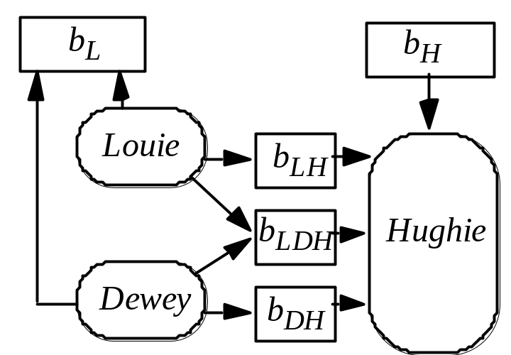
Compose Systems
Louie, Dewey LOW
Hughie HIGH
b_{L} output buffer
  Anyone can read it
b_{H} input buffer
  From HIGH source
Hughie reads from:
  b_{LH} (Louie writes)
  b_{LDH} (Louie, Dewey write)
  b_{DH} (Dewey writes)

Slide 85
Systems Secure
All systems individually noninterference-secure
  Hughie has no output
    So inputs don’t interfere with it
  Louie, Dewey have no input
    So (nonexistent) inputs don’t interfere with outputs

Slide 86
Security of Composition
Buffers finite, sends/receives blocking: composition not secure!
  Example: assume b_{DH}, b_{LH} have capacity 1
Algorithm:
  Louie (Dewey) sends message to b_{LH} (b_{DH})
    Fills buffer
  Louie (Dewey) sends second message to b_{LH} (b_{DH})
  Louie (Dewey) sends a 0 (1) to b_{L}
  Louie (Dewey) sends message to b_{LDH}
    Signals Hughie that Louie (Dewey) completed a cycle

Slide 87
Hughie
Reads bit from b_{H}
  If 0, receive message from b_{LH}
  If 1, receive message from b_{DH}
Receive on b_{LDH}
  To wait for buffer to be filled

Slide 88
Example
Hughie reads 0 from b_{H}
  Reads message from b_{LH}
Now Louie’s second message goes into b_{LH}
  Louie completes setp 2 and writes 0 into b_{L}
Dewey blocked at step 1
  Dewey cannot write to b_{L}
Symmetric argument shows that Hughie reading 1 produces a 1 in b_{L}
So, input from b_{H} copied to output b_{L}

Slide 89
Topics
Overview
Composition Problem
Deterministic Noninterference
Nondeducibility
Generalized Noninterference
Restrictiveness

Slide 90
Nondeducibility
Noninterference: do state transitions caused by high level commands interfere with sequences of state transitions caused by low level commands?
Really case about inputs and outputs:
  Can low level subject deduce anything about high level inputs or outputs from a set of low level outputs?

Slide 91
Example: 2-Bit System
High operations change only High bit
  Similar for Low
s0 = (0, 0)
Commands (Heidi, xor1), (Lara, xor0), (Lara, xor1), (Lara, xor0), (Heidi, xor1), (Lara, xor0)
  Both bits output after each command
Output is: 00101011110101

Slide 92
Security
Not noninterference-secure w.r.t. Lara
  Lara sees output as 0001111
  Delete High and she sees 00111
But Lara still cannot deduce the commands deleted
  Don’t affect values; only lengths
So it is deducibly secure
  Lara can’t deduce the commands Heidi gave

Slide 93
Event System
4-tuple (E, I, O, T)
  E set of events
  I ⊆ E set of input events
  O ⊆ E set of output events
  T set of all finite sequences of events legal within system
E partitioned into H, L
  H set of High events
  L set of Low events

Slide 94
More Events …
H∩I set of High inputs
H∩O set of High outputs
L∩I set of Low inputs
L∩O set of Low outputs
T_{Low} set of all possible sequences of Low events that are legal within system
π_{L}:T→T_{Low} projection function deleting all High inputs from trace
  _x0010_Low observer should not be able to deduce anything about High inputs from trace t_{Low} ∈ T_{low}

Slide 95
Deducibly Secure
System deducibly secure if, for every trace t_{Low} ∈ T_{Low}, the corresponding set of high level traces contains every possible trace t ∈ T for which π_{L}(t) = t_{Low}
  Given any t_{Low}, the trace t ∈ T producing that t_{Low} is equally likely to be any trace with π_{L}(t) = t_{Low}

Slide 96
Example
Back to our 2-bit machine
  Let xor0, xor1 apply to both bits
  Both bits output after each command
Initial state: (0, 1)
Inputs: 1_{H}0_{L}1_{L}0_{H}1_{L}0_{L}
Outputs: 10 10 01 01 10 10
Lara (at Low) sees: 001100
  Does not know initial state, so does not know first input; but can deduce fourth input is 0
Not deducibly secure

Slide 97
Example
Now xor0, xor1 apply only to state bit with same level as user
Inputs: 1_{H}0_{L}1_{L}0_{H}1_{L}0_{L}
Outputs: 1011111011
Lara sees: 01101
She cannot deduce anything about input
  Could be 0_{H}0_{L}1_{L}0_{H}1_{L}0_{L} or 0_{L}1_{H}1_{L}0_{H}1_{L}0_{L} for example
Deducibly secure

Slide 98
Security of Composition
In general: deducibly secure systems not composable
Strong noninterference: deducible security + requirement that no High output occurs unless caused by a High input
  Systems meeting this property are composable

Slide 99
Example
2-bit machine done earlier does not exhibit strong noninterference
  Because it puts out High bit even when there is no High input
Modify machine to output only state bit at level of latest input
  Now it exhibits strong noninterference

Slide 100
Problem
Too restrictive; it bans some systems that are obviously secure
Example: System upgrade reads Low inputs, outputs those bits at High
  Clearly deducibly secure: low level user sees no outputs
  Clearly does not exhibit strong noninterference, as no high level inputs!

Slide 101
Remove Determinism
Previous assumption
  Input, output synchronous
  Output depends only on commands triggered by input
    Sometimes absorbed into commands …
  Input processed one datum at a time
Not realistic
  In real systems, lots of asynchronous events

Slide 102
Topics
Overview
Composition Problem
Deterministic Noninterference
Nondeducibility
Generalized Noninterference
Restrictiveness

Slide 103
Generalized Noninterference
Nondeterministic systems meeting noninterference property meet generalized noninterference-secure property
  More robust than nondeducible security because minor changes in assumptions affect whether system is nondeducibly secure

Slide 104
Example
System with High Holly, Low lucy, text file at High
  File fixed size, symbol b marks empty space
  Holly can edit file, Lucy can run this program:
while true do begin
n := read_integer_from_user;
if n > file_length or char_in_file[n] = b then
print random_character;
else
print char_in_file[n];
end;

Slide 105
Security of System
Not noninterference-secure
  High level inputs—Holly’s changes—affect low level outputs
May be deducibly secure
  Can Lucy deduce contents of file from program?
  If output meaningful (“This is right”) or close (“Thes is riqht”), yes
  Otherwise, no
So deducibly secure depends on which inferences are allowed

Slide 106
Composition of Systems
Does composing systems meeting generalized noninterference-secure property give you a system that also meets this property?
Define two systems (cat, dog)
Compose them

Slide 107
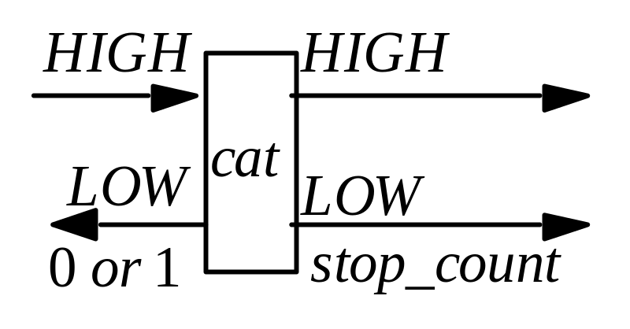
First System: cat
Inputs, outputs can go left or right
After some number of inputs, cat sends two outputs
  First stop_count
  Second parity of High inputs, outputs

Slide 108
Noninterference-Secure?
If even number of High inputs, output could be:
  0 (even number of outputs)
  1 (odd number of outputs)
If odd number of High inputs, output could be:
  0 (odd number of outputs)
  1 (even number of outputs)
High level inputs do not affect output
  So noninterference-secure

Slide 109
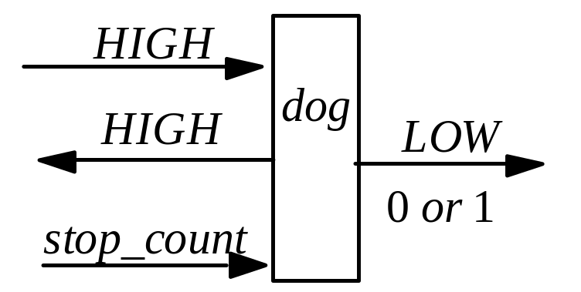
Second System: dog
High outputs to left
Low outputs of 0 or 1 to right
stop_count input from the left
  When it arrives, dog emits 0 or 1

Slide 110
Noninterference-Secure?
When stop_count arrives:
  May or may not be inputs for which there are no corresponding outputs
  Parity of High inputs, outputs can be odd or even
  Hence dog emits 0 or 1
High level inputs do not affect low level outputs
  So noninterference-secure

Slide 111
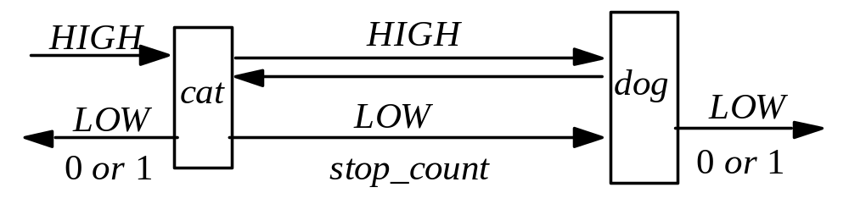
Compose Them
Once sent, message arrives
  But stop_count may arrive before all inputs have generated corresponding outputs
  If so, even number of High inputs and outputs on cat, but odd number on dog
Four cases arise

Slide 112
The Cases
cat, odd number of inputs, outputs; dog, even number of inputs, odd number of outputs
  Input message from cat not arrived at dog, contradicting assumption
cat, even number of inputs, outputs; dog, odd number of inputs, even number of outputs
  Input message from dog not arrived at cat, contradicting assumption

Slide 113
The Cases
cat, odd number of inputs, outputs; dog, odd number of inputs, even number of outputs
  dog sent even number of outputs to cat, so cat has had at least one input from left
cat, even number of inputs, outputs; dog, even number of inputs, odd number of outputs
  dog sent odd number of outputs to cat, so cat has had at least one input from left

Slide 114
The Conclusion
Composite system catdog emits 0 to left, 1 to right (or 1 to left, 0 to right)
  Must have received at least one input from left
Composite system catdog emits 0 to left, 0 to right (or 1 to left, 1 to right)
  Could not have received any from left
So, High inputs affect Low outputs
  Not noninterference-secure

Slide 115
Feedback-Free Systems
System has n distinct components
Components c_{i}, c_{j} connected if any output of c_{i} is input to c_{j}
System is feedback-free if for all c_{i} connected to c_{j}, c_{j} not connected to any c_{i}
  Intuition: once information flows from one component to another, no information flows back from the second to the first

Slide 116
Feedback-Free Security
Theorem: A feedback-free system composed of noninterference-secure systems is itself noninterference-secure

Slide 117
Some Feedback
Lemma: A noninterference-secure system can feed a high level output o to a high level input i if the arrival of o at the input of the next component is delayed until after the next low level input or output
Theorem: A system with feedback as described in the above lemma and composed of noninterference-secure systems is itself noninterference-secure

Slide 118
Why Didn’t They Work?
For compositions to work, machine must act same way regardless of what precedes low level input (high, low, nothing)
dog does not meet this criterion
  If first input is stop_count, dog emits 0
  If high level input precedes stop_count, dog emits 0 or 1

Slide 119
State Machine Model
2-bit machine, levels High, Low, meeting 4 properties:
For every input i_{k}, state σ_{j}, there is an element c_{m} ∈ C* such that T*(c_{m}, σ_{j}) = σ_{n}, where σ_{n} ≠ σ_{j}
  T* is total function, inputs and commands always move system to a different state

Slide 120
Property 2
There is an equivalence relation ≡ such that:
  If system in state σ_{i} and high level sequence of inputs causes transition from σ_{i} to σ_{j}, then σ_{i} ≡ σ_{j}
  If σ_{i} ≡ σ_{j} and low level sequence of inputs i₁, …, i_{n} causes system in state σ_{i} to transition to σ_{i}′, then there is a state σ_{j}′ such that σ_{i}′ ≡ σ_{j}′ and the inputs i₁, …, i_{n} cause system in state σ_{j} to transition to σ_{j}′
≡ holds if low level projections of both states are same

Slide 121
Property 3
Let σ_{i} ≡ σ_{j}. If high level sequence of outputs o₁, …, o_{n} indicate system in state σ_{i} transitioned to state σ_{i}′, then for some state σ_{j}′ with σ_{j}′ ≡ σ_{i}′, high level sequence of outputs o₁′, …, o_{m}′ indicates system in σ_{j} transitioned to σ_{j}′
  High level outputs do not indicate changes in low level projection of states

Slide 122
Property 4
Let σ_{i} ≡ σ_{j}, let c, d be high level output sequences, e a low level output. If ced indicates system in state σ_{i} transitions to σ_{i}′, then there are high level output sequences c’ and d’ and state σ_{j}′ such that c′ed′ indicates system in state σ_{j} transitions to state σ_{j}′
  Intermingled low level, high level outputs cause changes in low level state reflecting low level outputs only

Slide 123
Topics
Overview
Composition Problem
Deterministic Noninterference
Nondeducibility
Generalized Noninterference
Restrictiveness

Slide 124
Restrictiveness
System is restrictive if it meets the preceding 4 properties

Slide 125
Composition
Intuition: by 3 and 4, high level output followed by low level output has same effect as low level input, so composition of restrictive systems should be restrictive

Slide 126
Composite System
System M₁’s outputs are M₂’s inputs
μ_{1i}, μ_{2i} states of M₁, M₂
States of composite system pairs of M₁, M₂ states (μ_{1i}, μ_{2i})
e event causing transition
e causes transition from state (μ_{1a}, μ_{2a}) to state (μ_{1b}, μ_{2b}) if any of 3 conditions hold

Slide 127
Conditions
M₁ in state μ_{1a} and e occurs, M₁ transitions to μ_{1b}; e not an event for M₂; and μ_{2a} = μ_{2b}
M₂ in state μ_{2a} and e occurs, M₂ transitions to μ_{2b}; e not an event for M₁; and μ_{1a} = μ_{1b}
M₁ in state μ_{1a} and e occurs, M₁ transitions to μ_{1b}; M₂ in state μ_{2a} and e occurs, M₂ transitions to μ_{2b}; e is input to one machine, and output from other

Slide 128
Intuition
Event causing transition in composite system causes transition in at least 1 of the components
If transition occurs in exactly one component, event must not cause transition in other component when not connected to the composite system

Slide 129
Equivalence for Composite
Equivalence relation for composite system
(σ_{a}, σ_{b}) ≡_{C} (σ_{c}, σ_{d}) iff σ_{a} ≡ σ_{c} and σ_{b} ≡ σ_{d}
Corresponds to equivalence relation in property 2 for component system

Slide 130
Key Points
Composing secure policies does not always produce a secure policy
  The policies must be restrictive
Noninterference policies prevent HIGH inputs from affecting LOW outputs
  Prevents “writes down” in broadest sense
Nondeducibility policies prevent the inference of HIGH inputs from LOW outputs
  Prevents “reads up” in broadest sense

